Slide 1
BUSINESS PERFORMANCE ANALYSIS
Northwind Business Performance Analysis
Prepared by Favour Ubani · Data Analyst
A comprehensive review of sales, products, customers, markets, employee performance, and shipping operations — designed to support informed executive decision-making.

Slide 2
EXECUTIVE SUMMARY
What the Data Reveals
Analysis spans sales revenue, product and category performance, customer and market dynamics, employee contribution, and shipping operations across the Northwind order history.
Scale & Scope
Revenue Trend
~$1.35M total revenue across 809 orders, 91 customers, 77 products, and 8 categories.
Revenue rose over the available period; April 1998 is the highest visible month at ~$121K.
Geographic Leaders
Operations & Data Quality
USA ($261K) and Germany ($242K) dominate revenue. Concentration is high across markets, products, and customers.
772 of 809 orders shipped on time. 21 OrderIDs in OrderDetails have no matching Orders record — a data-quality exception requiring reconciliation.

Slide 3

BUSINESS PERFORMANCE
Core KPIs at a Glance
$1.35M
809
Total Revenue
Total Orders
Across all recorded orders
Fulfilled across the period
89
~51K
Purchasing Customers
Units Sold
Out of 91 total customers
Total quantity across all products
$1.63K
77
Avg. Order Value
Active Products
Healthy per-order spend
Across 8 categories
Revenue is substantial and diversified, but concentration across leading products, customers, and markets — and 21 unmatched OrderIDs — warrant ongoing monitoring.

Slide 4
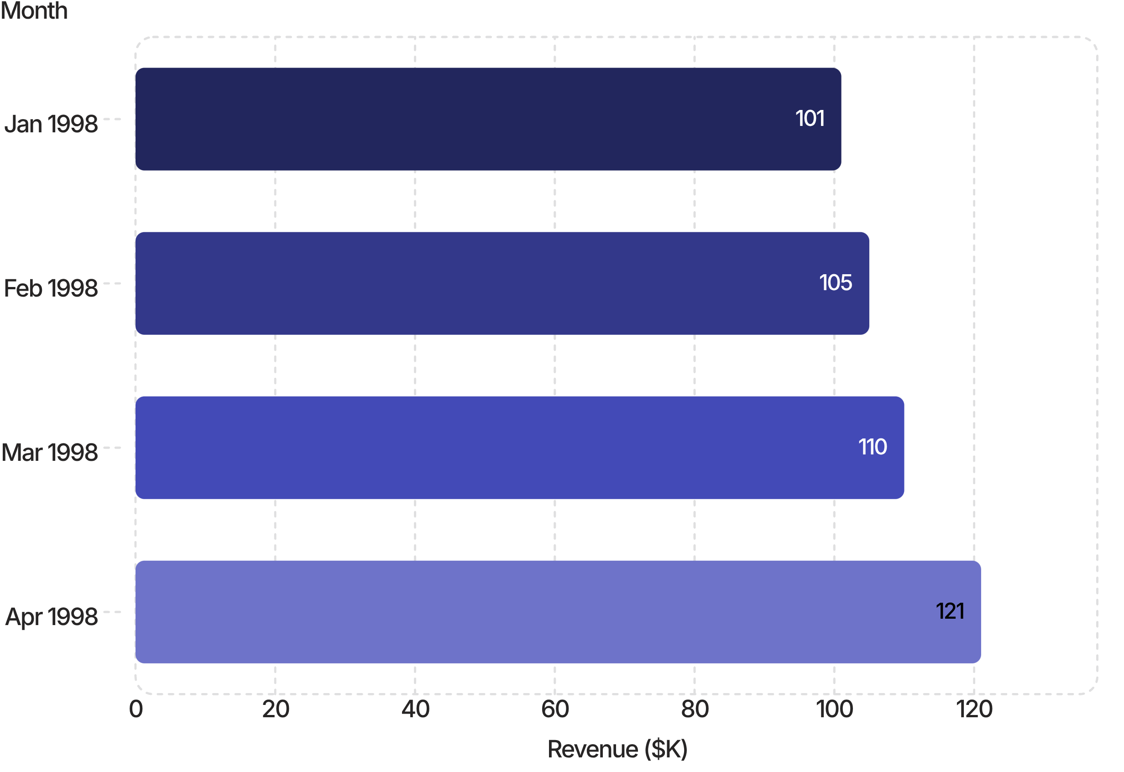
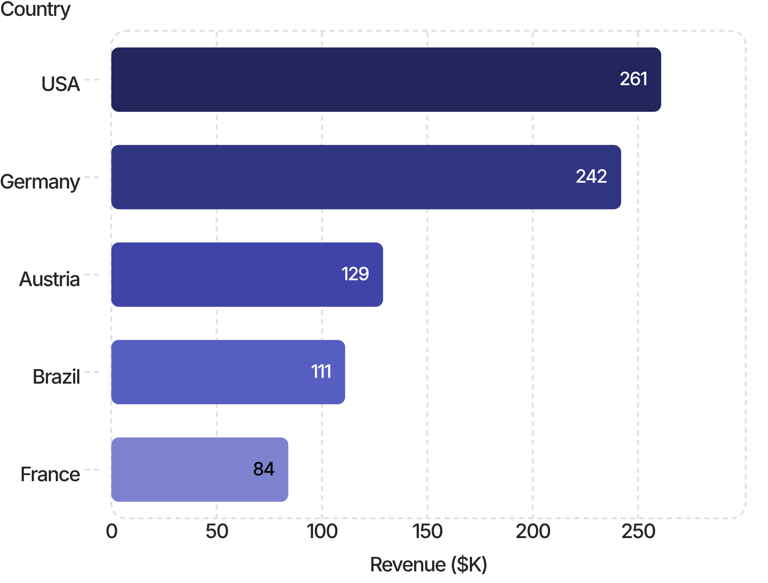
SALES PERFORMANCE
Revenue Growth & Geographic Reach
Monthly Revenue Peaks (1998)
Top Revenue Countries
Avg. Order Value: ~$1.63K. Sales growth is supported by strong market performance. Management should identify drivers of peak months and replicate effective patterns.

Slide 5
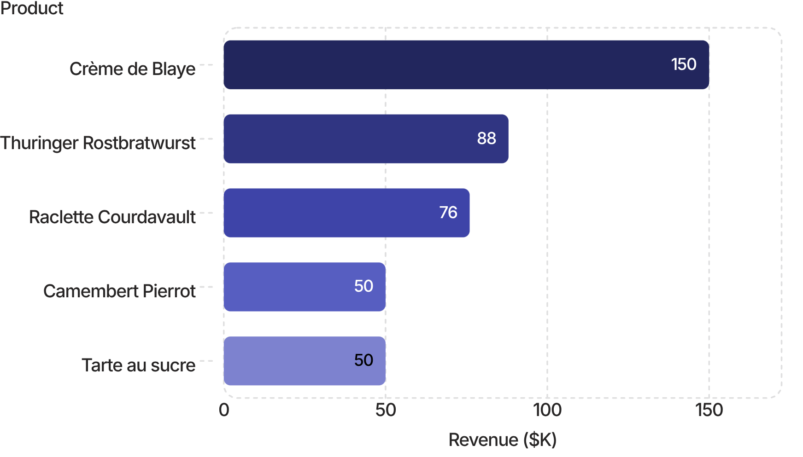

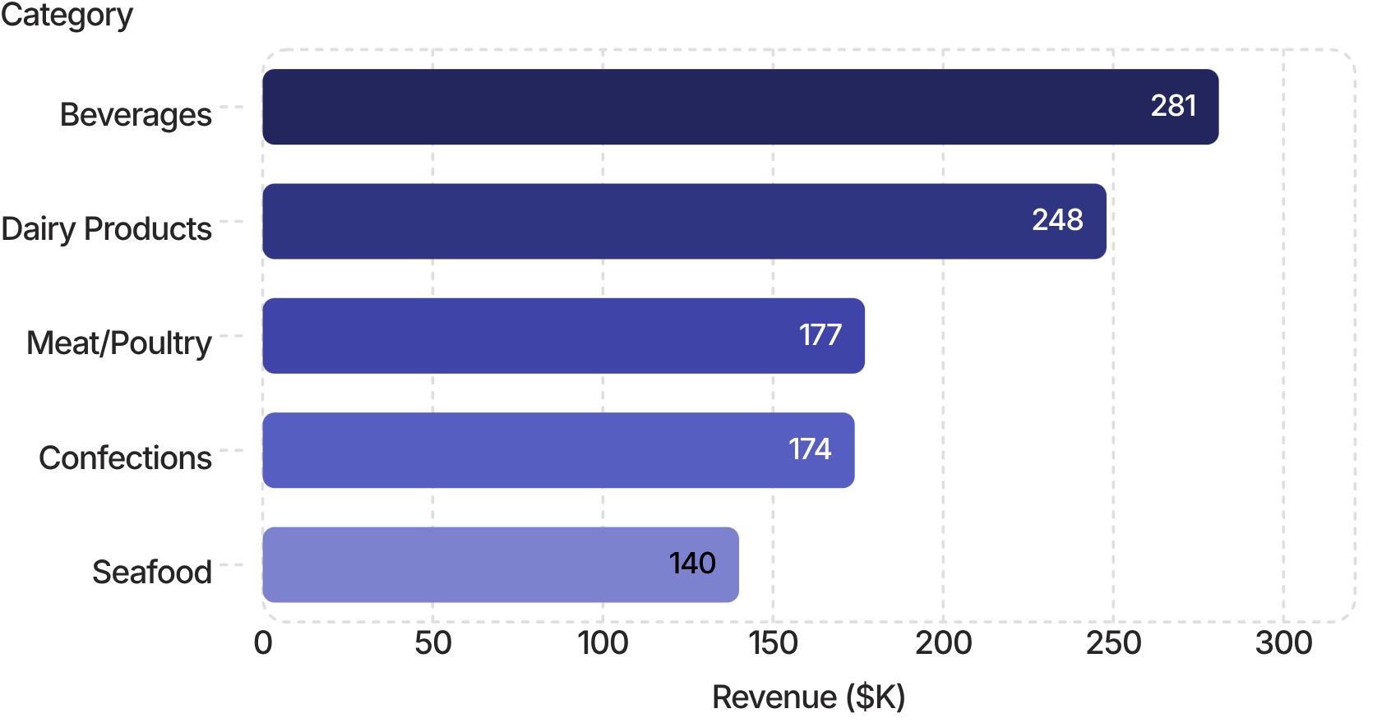
PRODUCT PERFORMANCE
Leading Products, Categories & Portfolio Risks
Top Products by Revenue
Low-Revenue Products — Under Review
Product | Revenue
Chocolate | $1.54K
Gelatost | $1.71K
Genen Shoyu | $1.81K
Longlife Tofu | $2.56K
Laughing Lumberjack Lager | $2.56K
Discontinued product strategy: limit new inventory investment, clear remaining stock, reduce replenishment, offer suitable alternatives, and review demand before any final discontinuation decision.
Top Categories by Revenue

Slide 6
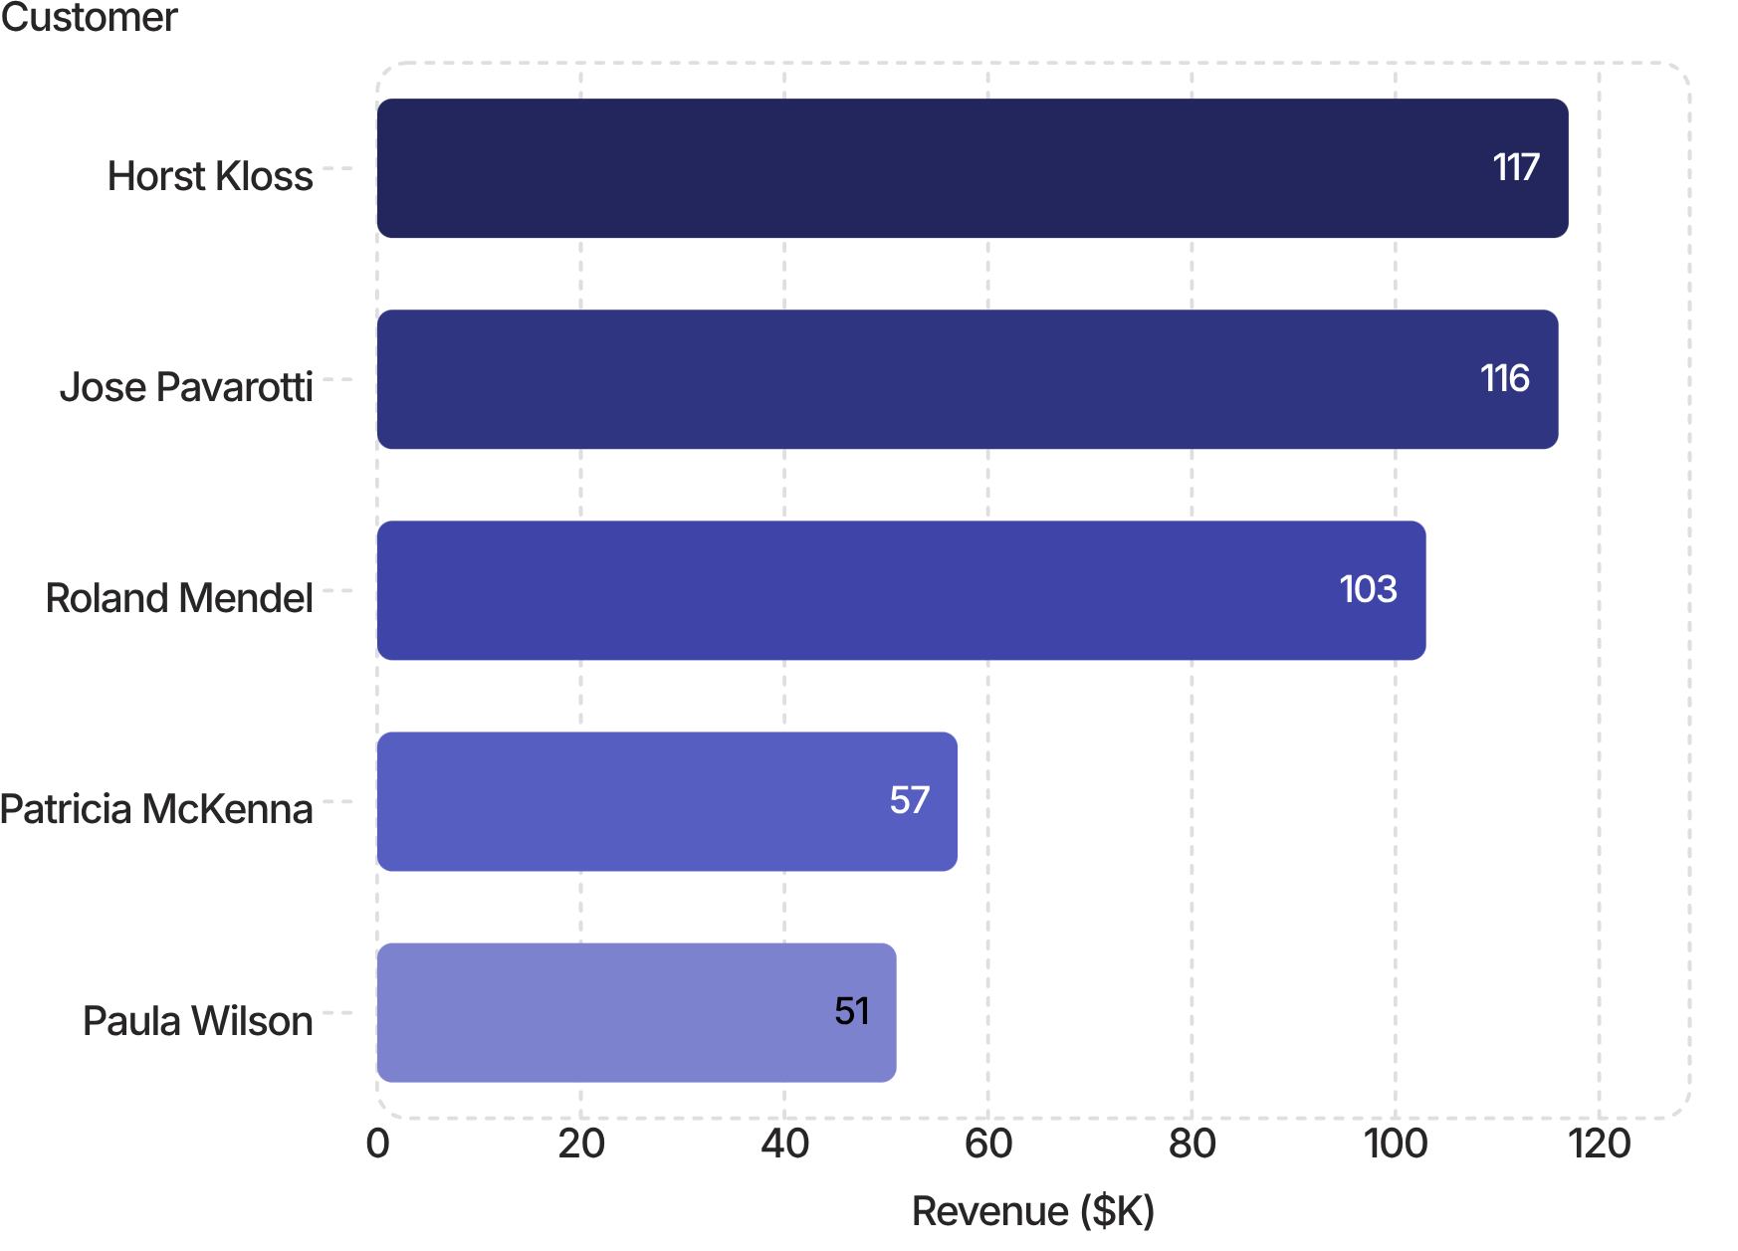

CUSTOMER & MARKET PERFORMANCE
Revenue Concentration Across Customers & Markets
Top Customers by Revenue Contribution
Key Markets: Revenue vs. Customer Count
Market | Revenue | Customers
USA | $261K | 13
Germany | $242K | 11
Austria | $129K | 2
Brazil | $111K | 9
Poland | $3.5K | 1
Norway | $5.7K | 1
Argentina | $7.7K | 3
Bottom contributors (Francisco Chang ~0.03%, John Steel ~0.04%, Yoshi Tannam ~0.05%) represent negligible revenue and merit targeted development.
Austria's $129K from just 2 customers signals significant concentration risk. Lower-revenue markets represent untapped growth opportunity with targeted acquisition and promotions. Market performance varies not only by revenue but also by customer base. Austria generates approximately $129K from just 2 customers, while Italy generates $16.2K from 3 customers and Argentina generates $7.7K from 3 customers. This highlights differences in revenue concentration and customer value across markets.

Slide 7
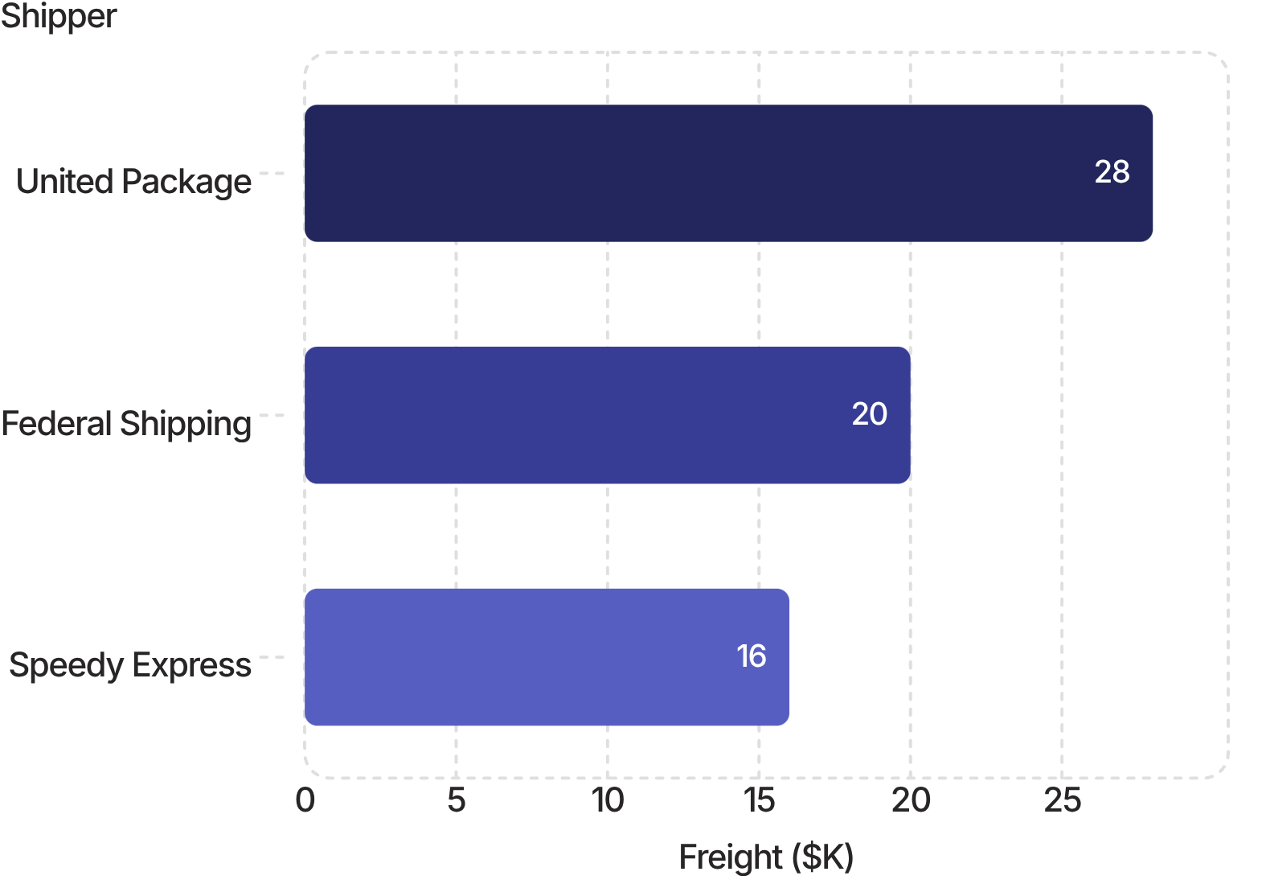
OPERATIONAL INSIGHTS
Employee Performance & Shipping Operations
Employee Performance — Orders, Revenue & AOV
Shipping Performance
Employee | Orders | Revenue % | AOV
Peacock, M. | 151 | 17.9% | $1,607
Leverling, J. | 127 | 15.7% | $1,678
Davolio, N. | 120 | 14.6% | $1,643
Fuller, A. | 93 | 12.8% | $1,868
King, R. | 69 | 10.0% | $1,973
Callahan, L. | 100 | 9.6% | $1,298
Dodsworth, A. | 42 | 6.1% | $1,955
Suyama, M. | 65 | 5.7% | $1,182
Buchanan, S. | 42 | 5.6% | $1,799
Freight Cost by Shipper
Note: Higher revenue does not automatically mean higher productivity. Evaluate order volume, revenue contribution,
772 On-Time
37 Late
Freight Costs
95.4% of all orders
4.6% late shipment rate
United Package $28K · Federal $20K · Speedy $16K

Slide 8
KEY BUSINESS INSIGHTS
Evidence-Based Findings for Leadership
1
Revenue Concentration
A small set of products, customers, and markets drives the majority of revenue — creating both strength and dependency risk.
2
Geographic Leaders
USA ($261K) and Germany ($242K) lead. Austria delivers $129K from just 2 customers — a notable concentration risk.
3
Category Strength
Beverages ($281K) and Dairy Products ($248K) are the top two categories and should be protected and grown.
4
Peak Sales in Early 1998
April 1998 (~$121K) marks the highest visible month. Identifying and replicating those drivers is a key strategic opportunity.
5
Employee Performance Is Multi-Dimensional
Order volume, revenue share, and AOV vary significantly. Performance management requires all three metrics together.
6
Shipping & Data Quality
95.4% of orders ship on time. However, 21 unmatched OrderIDs limit date-, customer-, and market-level analysis reliability.

Slide 9
RECOMMENDATIONS
Strategic Actions for Management
1
Protect Key Markets
1
Refine Performance Management
Prioritize retention and repeat-purchase strategies in USA and Germany. Deepen customer development in Austria given its high concentration risk.
Evaluate employees using order volume, revenue contribution, and AOV together — not revenue alone — for balanced insight.
2
Grow the Product Portfolio
2
Optimize Shipping Operations
Expand leading categories through cross-selling and bundles. Review and clear low-revenue and discontinued products before new inventory allocation.
Review shipper freight-cost differences, investigate late orders, and examine slower-shipping customer country patterns.
3
Replicate Peak Performance
3
Resolve Data Quality
Investigate Q1 1998 sales drivers and replicate the most effective customer/product combinations across other periods.
Reconcile 21 unmatched OrderIDs in OrderDetails before relying on date-, customer-, or market-level analysis for decisions.

Slide 10

CONCLUSION
What the Data Tells Us — and What to Do Next
Revenue Foundation
Operational Strength
Opportunities Ahead
Northwind has a strong ~$1.35M base with clear growth over time, led by dominant markets, products, and customers.
95.4% on-time shipping and a healthy $1.63K average order value confirm sound operational execution.
Customer development, inventory optimization, shipping efficiency, and data-quality resolution will unlock further value.
Retain Customers
Optimize Portfolio
Monitor Performance
Resolve Data Issues

